Slide 1


Objectives
In this session, you will learn to:
Understand scripting
Implement JavaScript in Web pages
Use variables, operators, and control structures
Implement functions

Slide 2
Types of Scripting
A script:
Is a block of code that is incorporated in Web pages to make them dynamic and interactive.
Can be of two types:
Client-side
Server-side

Slide 3
Identifying the Benefits of JavaScript
JavaScript provides the following benefits:
Handle events
Gather browser information
Manipulate cookies

Slide 4
Implementing JavaScript in Web Pages
JavaScript:
Is a client-side scripting language.
Can be directly embedded into a Web page by writing the code inside the <SCRIPT> tag.
Code can also be written in an external JavaScript (.js) file.

Slide 5
Embedding a Script into a Web Page
The JavaScript code:
Can be inserted in the following sections of the HTML document by using the <SCRIPT> tag:
Can be embedded into a Web page by using the following syntax:
<SCRIPT type="text/javascript"> JavaScript statements
</SCRIPT>
Head
If the script is meant to be executed in response to an action performed by the user
Body
If the script needs to be executed as soon as the page is loaded

Slide 6
Creating and Using an External File
An external JavaScript file:
Is saved with the .js extension.
Can be referred inside an HTML document using the src attribute of the <SCRIPT> tag.

Slide 7
Identifying Rules and Conventions Used in JavaScript
JavaScript rules and conventions:
Semicolons
Quotes
Case sensitivity
Comments

Slide 8
Using Variables, Operators, and Control Structures
In JavaScript, to compare values and evaluate expressions, you need:
Variables
Operators
Conditional Constructs
Looping Constructs

Slide 9
Defining Variables
A variable:
Is a named location in memory that is used to store a value.
Is declared by using the following syntax:
var var_name;
Can be assigned a value in the following ways:
After declaration
var employeeName;
employeeName="Peter";
With declaration
var employeeName="Peter";
Without declaration
employeeName="Peter";

Slide 10
Using Operators
An operator:
Is a set of one or more characters that is used for computations or comparisons.
Can be used to modify the values stored in the variables.
Can belong to any one of the following categories:
Arithmetic
Assignment
Arithmetic Assignment
Comparison
Logical

Slide 11
Using Operators (Contd.)
An arithmetic operator:
Is used to perform arithmetic operations on variables and literals.
Can be of the following types:
+
-
*
/
%
An assignment operator:
Is used to assign a value or a result of an expression to a variable.

Slide 12
Using Operators (Contd.)
Arithmetic assignment operators:
Are used to perform arithmetic operations and assign the value to the variable at the left side of the operator.
Are of the following types:
+=
-=
*=
/=
%=

Slide 13
Using Operators (Contd.)
Comparison operators:
Are used to compare two values and perform an action on the basis of the comparison.
Are of the following types:
<
>
<=
>=
==
!=
===

Slide 14
Using Operators (Contd.)
Logical operators:
Are used to evaluate complex expressions.
Return a boolean value.
Are of the following types:
&&
!
||

Slide 15
Using Operators (Contd.)
Demo code for each operators

Slide 16
Using Conditional Constructs
Conditional constructs:
Allow you to execute a block of statements based on the result of the expression being
evaluated.
Can be of the following types:
if...else
switch...case

Slide 17
Using Conditional Constructs (Contd.)
The if…else construct:
Is used to evaluate the specified condition and perform actions on the basis of the result of evaluation.
Has the following syntax:
if (exp)
{
// Statements;
}
else
{
// Statements;
}
The switch…case construct is used when you need to evaluate a variable for multiple values.
The following embedded Notepad file contains the code to understand the use of
switch…case construct in HTML:

Slide 18
Using Conditional Constructs (Contd.)
Demo code for if..else and switch..case construct

Slide 19
Using Loop Constructs
Loop structures:
Are used to repeatedly execute one or more lines of code.
Can be of the following types:
while
do...while
for

Slide 20
Using Loop Constructs (Contd.)
The while loop:
Is used to repeatedly execute a block of statements till a condition evaluates to true.
Always checks the condition before executing the statements in the loop.
Has the following syntax:
while (expression)
{
statements;
}

Slide 21
Using Loop Constructs (Contd.)
The do…while loop:
Is executed at least once, even if the condition evaluates to false.
Has the following syntax:
do
{ Statements;
}
while(condition)

Slide 22
Using Loop Constructs (Contd.)
The for loop:
Allows the execution of a block of code depending on the result of the evaluation of the
test condition.
Has the following syntax:
for (initialize variable; test condition; step value)
{
// code block
}

Slide 23
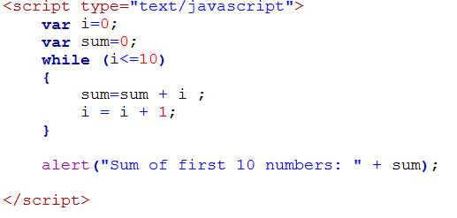
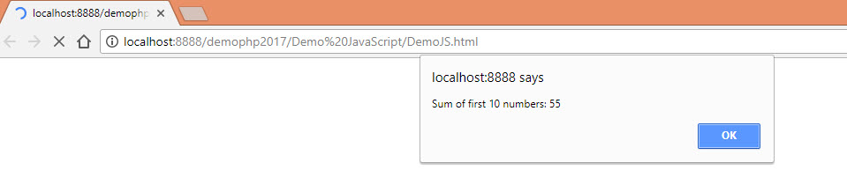
Using Loop Constructs (Contd.)
Example:
Output:

Slide 24
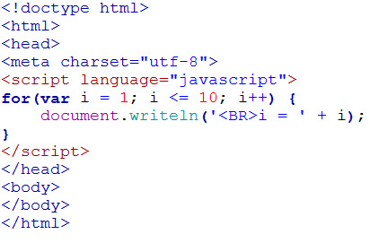
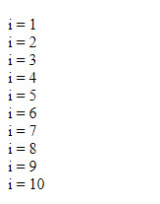
Using Loop Constructs (Contd.)
Example:
Output:

Slide 25
Break and Continue Statements
The break statement:
Is used to exit the loop.
Prevents the execution of the remaining statements of the loop.
Is usually placed within an if construct inside the loop.
The continue statement:
Is used to skip all the subsequent instructions and take the control back to the beginning of the loop.

Slide 26
Implementing Functions
Functions are used to write the code that needs to reused.
They optimize the performance of the code.

Slide 27
Introducing Functions
Functions:
Are a self-contained block of statements that have a name.
Are of the following types:
Built-in
User-defined

Slide 28
Introducing Functions (Contd.)
Built-in functions:
Are ready to use as they are already coded.
For example:
User-defined functions:
Are defined according to the need of the user.
isNaN()
parseInt()
eval()
prompt()
confirm()
parseFloat()

Slide 29
Accessing Functions
A function is called by using the following syntax: functionName (); or
functionName (parameter1, parameter 2...);
A function returns a value by using the return statement as displayed in the following example:
function functionName()
{
var variable=10;
return variable;
}

Slide 30
Creating Functions
Functions:
Are created by using the keyword, function, followed by the function name and the parentheses.
Are normally defined in the head section of a Web page.
Can optionally accept a list of parameters.
Are created using the following syntax:
function [functionName] (Variable1, Variable2)
{
//function statements
}

Slide 31
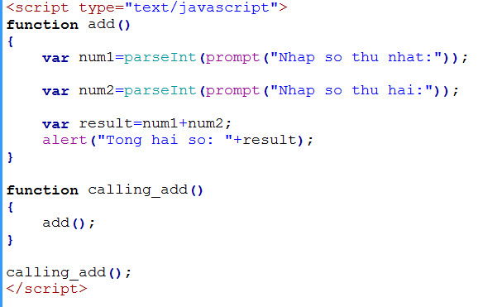
Example
Example:

Slide 32
Summary
In this session, you learned that:
In JavaScript, the following conditional constructs can be used:
if...else
switch...case
In JavaScript, the following loop structures can be used:
while
do...while
for
A function is a self-contained block of statements that has a name.
Some of the built-in functions supported by JavaScript are:
isNaN()
parseInt()
parseFloat()
eval()
prompt()
confirm()
Functions are created by using the keyword, function, followed by the function name and the parentheses.
Functions can return a value using the return statement.

